Slide 1
IEEE Central Texas Section 2018 Fall Leadership Planning Meeting August 25, 2018 San Marcus, TX
Officer Name: Kai Wong
Chapter/Affinity Name: IEEE Life Member - Austin
Prepared by: Kai Wong

Slide 2
Mission and Leadership Team
Mission/2018 Focused Initiatives*
The Austin Life Members' Group promotes the development of members through professional and social networking, addressing topics of interest to Life Members, including volunteer activities, and supports the IEEE Central Texas Section.
Leadership Team
Position Name Email
Chair Kai Wong kaiwong@ieee.org
Vice Chair Tom Grim t.grim@ieee.org
Treasurer Bill Martino bill.martino@ieee.org
Secretary Open
Webmaster/vtools Open
Program Open
Member at large John Purvis John.Purvis@ieee.org
(*) These can be technical meetings, workshops, networking events, etc.

Slide 3
2018 Key Accomplishments
Meetings (month, topic, L31):
Feb 20,2018: THE DEFENSE LABORATORIES OFFICE and THE DEFENSE RESEARCH ENTERPRISE ASSESSMENT Filed L31
March 20, 2018: Tax Information and Market Strategy Filed L31
April 17, 2018: Creation of a Food Forest in Backyard Gardening filed L31
Jun 19, 2018: Past, Present, and Future Climate Change Impacts on Water in a Semi-Arid Region: Science and Policy filed L31
July 17, 2018: Quantum Computing Filed L31
Aug 21, 2018: The Cable Speedy Delivery Time Domain Reflectometer (TDR) Filed L31
Other Activities/Events:
Jan 18, 2018: Volunteers (5) for Science Thursday at Texas State Museum

Slide 4
2018 Chapter Vitality & Help Needed
Chapter Vitality Assessment
** Ok but Need Improvement
Low attendance. Less than 8 and best was 17 in July 2018 on topic of Quantum Computing
Given that we have more than 300 Life member in the area, we cannot attract enough volunteers.
Host joint events - September 8 2018 Consultants Workshop on Risk Management.
Top Help Needed/Issues
Opportunity to recruit good speaker and interesting topic to increase attendance
Opportunity to recruit volunteers and target recent retirees.

Slide 5
Others/Backup
Xxxxx
xxxx

Slide 6
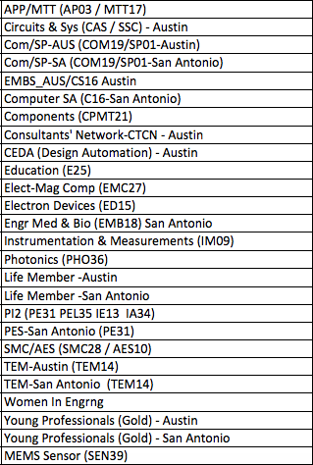
CTS Leadership
CTS Officers
Chapters/Affinity
Standing Committees/Coordinators
Chair
Fawzi Behmann
Vice Chair – A
Fabio Gomez
Vice Chair – SA
Ehsaneh Sunny Shahhaidar
Secretary
Raymond Choo
Treasurer
Bill Martino
Past Chair
Leslie Martinich
Past Past Chairs
Kenny Rice
Strategic Plan
Policies and Procedures PARP
Awards and Recognition
Membership Development
Electronics Communications
Website
vTools
Communications Portal
Conferences/Events
Section-Chapter Vitality Chair
Finance
K-12/STEM Educational Activities
Students Activities
Professional Activities – PACE
Outreach Program
Humanitarian

